Slide 1

Machine Learning
Lecture - 2
Muhammad Affan Alim

Slide 2
Learning Algorithm(Function)
Regression
Regression is a supervised learning problem
At given X and Y, we need to develop a model of linear regression which predict Y on new value of X
f : X Y
For regression Y is continuous

Slide 3
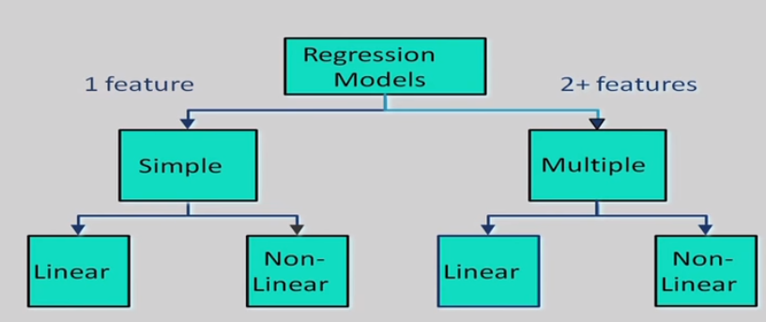
Hierarches of Regression
Many types of regression models can be used

Slide 4
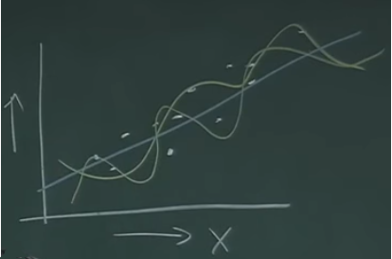
Linear Regression
The simplest function is linear function for regression
Simple regression where instance x depends on single variable
Multiple regression where instance x depends on multiple variables

Slide 5
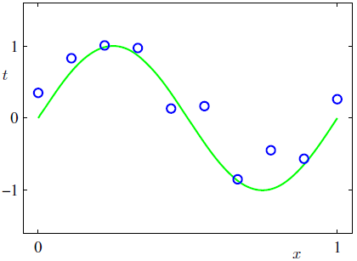
A simple Example: Fitting a Polynomial
There green curve is the true function
Plot of a training data set of N=10
points, shown as blue circles, each
comprising an observation of the input
variable x along with the corresponding
target variable t.
The green curve shows the function sin(2πx) used to generate the data

Slide 6
A simple Example: Fitting a Polynomial
We may used a loss function that measures the squared error in the prediction of y(x) from x

Slide 7
Some fits to the data: which is best? (1/2)
d

Slide 8
Some fits to the data: which is best? (2/2)
Explanation
We notice that the constant (M=0) and first order (M=1) polynomials give rather poor fits to the data and consequently rather poor representations of the function sin(2πx). The third order (M=3) polynomial seems to give the best fit to the function sin(2πx) of the examples shown in figure.
When we go to a much higher order polynomial (M=9), we obtain an excellent fit to the training data.
In fact, the polynomial passes exactly through each data point and E(w*) = 0.

Slide 9
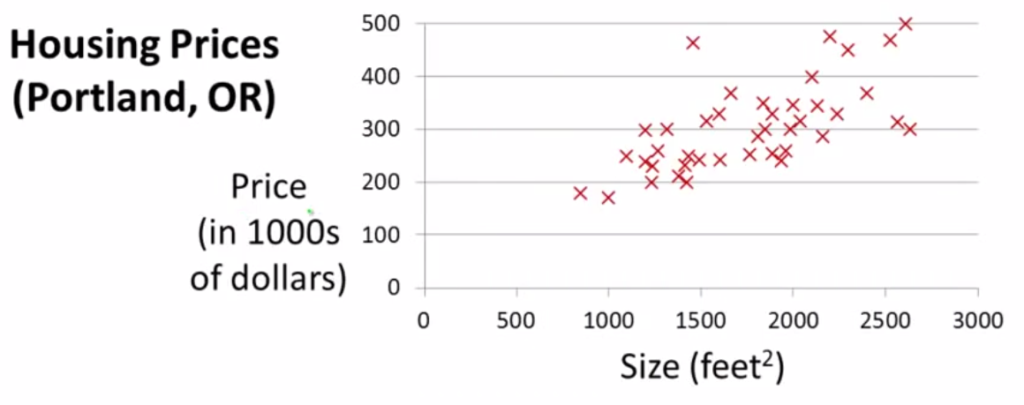
Linear Regression – Example (1/7)

Slide 10
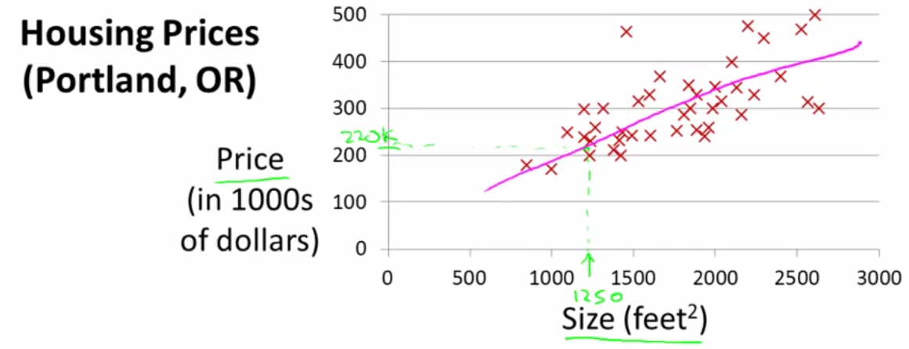
Linear Regression – Example (2/7)
This an example of supervised learning

Slide 11
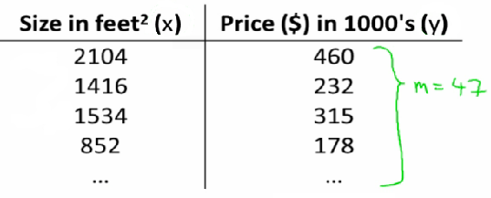
Linear Regression – Example (3/7)
d

Slide 12
Linear Regression – Example (4/7)
Training set (this is your data set)
Notation (used throughout the course)
m = number of training examples
x's = input variable "target" variables
y's = output variable target example
(x, y) - single training example
(x^{i}, y^{j}) - specific example (i^{th} training example)
i is index to training set

Slide 13
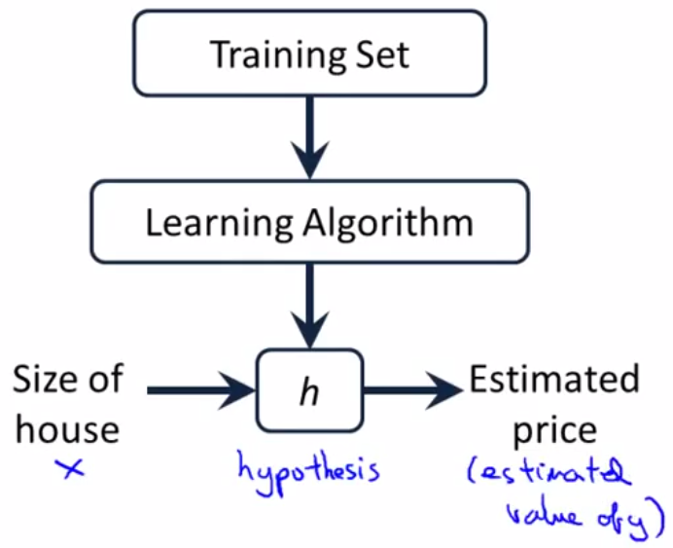
Linear Regression – Example (5/7)
h is a function which maps x’s to y’s

Slide 14
Linear Regression – Example (6/7)
With our training set defined - how do we used it?
Take training set
Pass into a learning algorithm
Algorithm outputs a function (denoted h ) (h = hypothesis)
This function takes an input (e.g. size of new house)
Tries to output the estimated value of Y

Slide 15
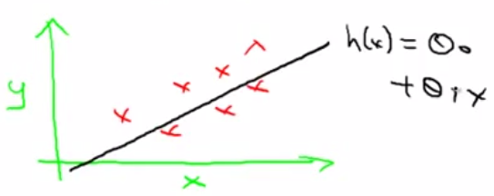
Linear Regression – Example (7/7)
How do we represent hypothesis h ?
Going to present h as;
h_{θ}(x) = θ₀ + θ₁x
h(x) (shorthand)
What does this mean?
Means Y is a linear function of x!
θ_{i} are parameters
θ₀ is zero condition
θ₁ is gradient
Linear regression with one variable or univariate linear regression

Slide 16
Linear Regression – Cost Function (1/7)
h_{θ}(x) = θ₀ + θ₁x
A cost function lets us figure out how to fit the best straight line to
our data
Choosing values for θ_{i} (parameters)

Slide 17
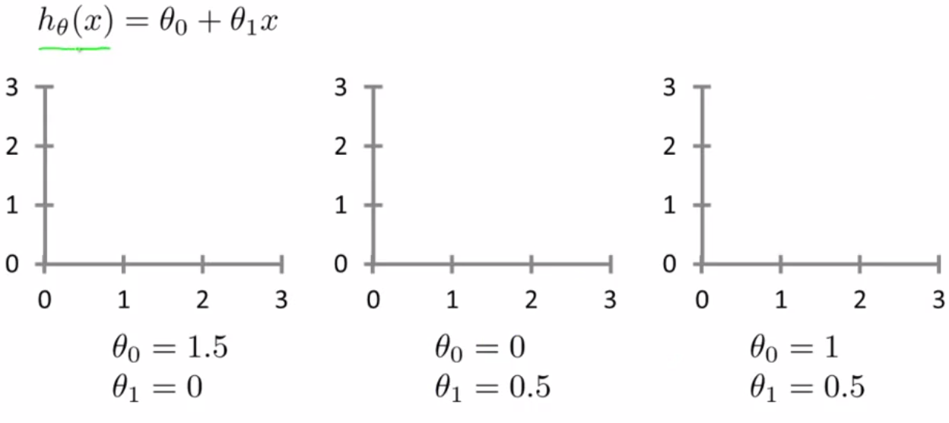
Linear Regression – Cost Function (2/7)
d

Slide 18
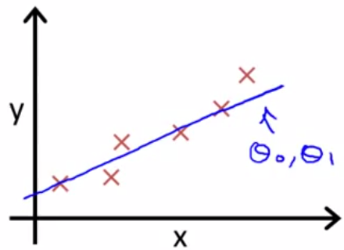
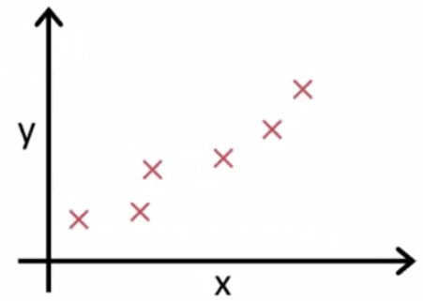
Linear Regression – Cost Function (3/7)
h_{θ}(x) = θ₀ + θ₁x

Slide 19
Linear Regression – Cost Function (4/7)
Idea: Choose θ_{1,} θ₂ so that h(x) is close to y for our training examples (x, y)
To formalize this;
We want to solve a minimization problem
Minimize (h_{θ}(x) – y)²
i.e. minimize the difference between h(x) and y for each/any/every example
Sum this over the training set

Slide 20
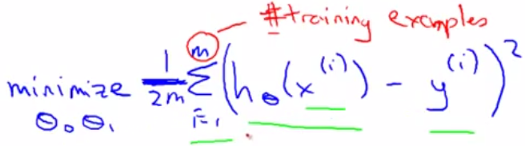
Linear Regression – Cost Function (5/7)
Sum this over the training set
Minimize squared different between predicted house price and actual house price

Slide 21
Linear Regression – Cost Function (6/7)
Note:
(1/2)m
1/m - means we determine the average
(1/2)m the 2 makes the math a bit easier, and doesn't change the constants we determine at all (i.e. half the smallest value is still the smallest value!)

Slide 22
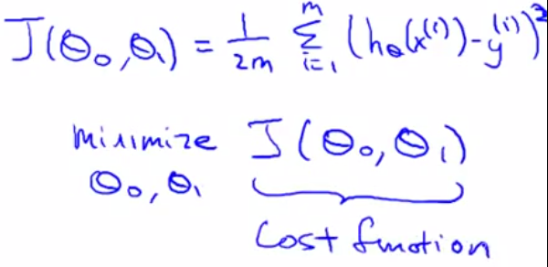
Linear Regression – Cost Function (7/7)
More cleanly, this is a cost function
Some time it is called squared error function

Slide 23
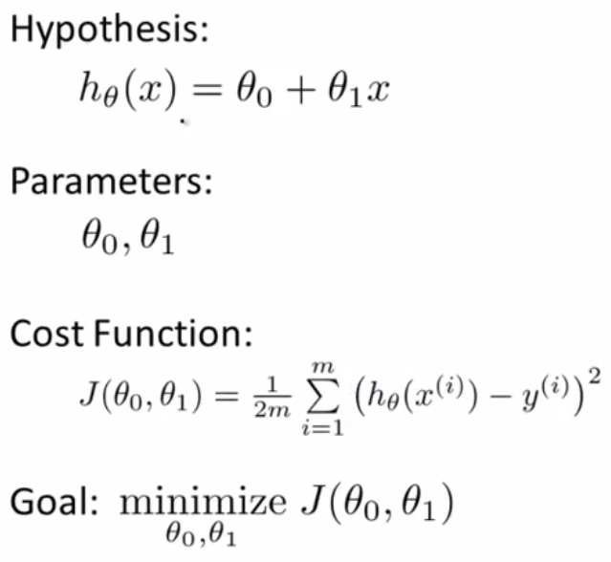
Linear Regression – Cost Function Summary

Slide 24
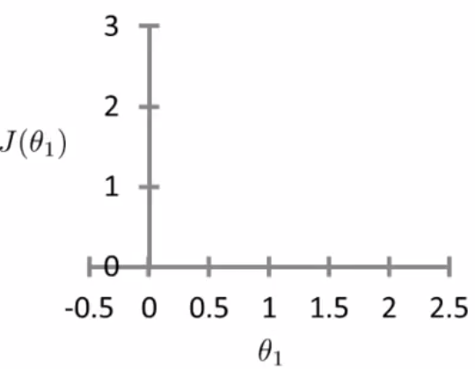
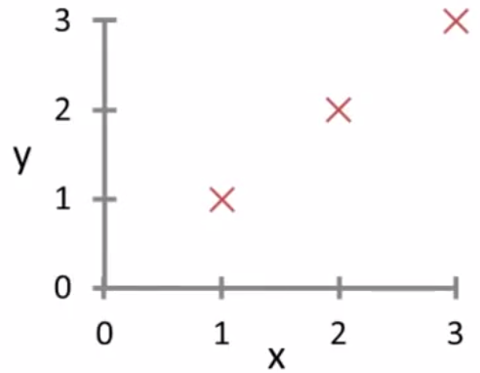
Linear Regression – Cost Function Example (1/4)
h_{θ}(x) J(θ₁)
(for fixed θ₁ this is a function of x) Function of the parameter θ₁

Slide 25
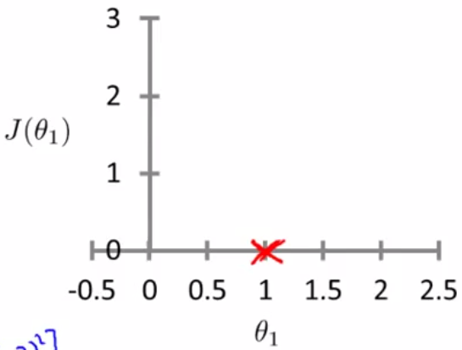
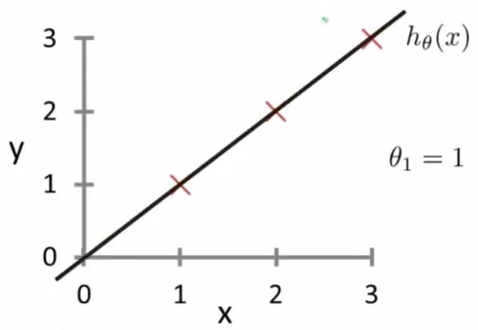
Linear Regression – Cost Function Example (2/4)
h_{θ}(x) J(θ₁)
(for fixed θ₁ this is a function of x) Function of the parameter θ₁

Slide 26
Linear Regression – Cost Function Example (3/4)
If θ₁=1 (page number 13)
J(1) = 0
If θ₁=0.5
J(0.5) = 0.58
If θ₁=0
J(0) = 2.3
We can do for other values of θ₁‘s

Slide 27
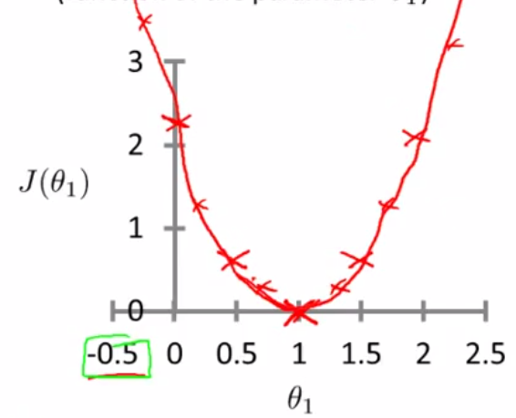
Linear Regression – Cost Function Example (4/4)
The optimization objective for the learning algorithm is find the value of θ₁ which minimizes J(θ₁)
So, here θ₁ = 1 is the best value for θ₁

Slide 28
Linear Regression – Cost Function Two or more constants (1/10)
Assume you're familiar with contour plots or contour figures
Using same cost function, hypothesis and goal as previously
It's OK to skip parts of this section if you don't understand contour plots
Using our original complex hypothesis with two variables,
So cost function is
J(θ₀, θ₁)

Slide 29
Linear Regression – Cost Function Two or more constants - Example (2/10)
Suppose
θ₀ = 50 and θ₁ = 0.06
Previously we plotted our cost function by plotting θ₁ vs J(θ₁)
Now we have two parameters
Plot becomes a bit more complicated
Generates a 3D surface plot where axis are
X = θ₁
Z = θ₀
Y = J(θ₀, θ₁)

Slide 30
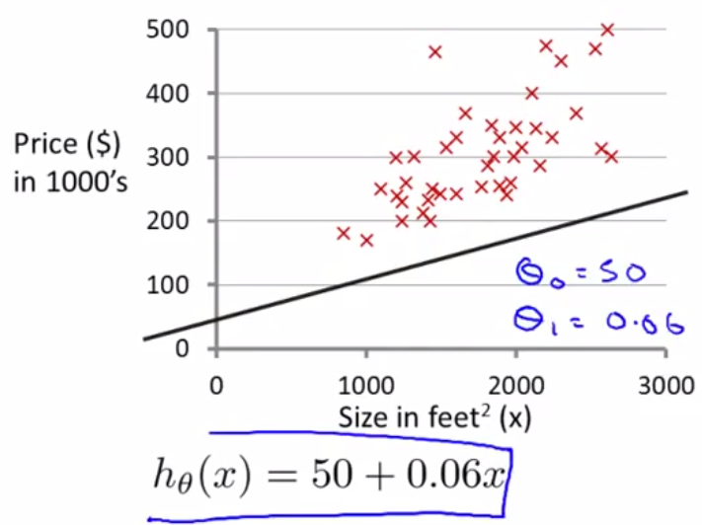
Linear Regression – Cost Function Two or more constants – Example (3/10)

Slide 31
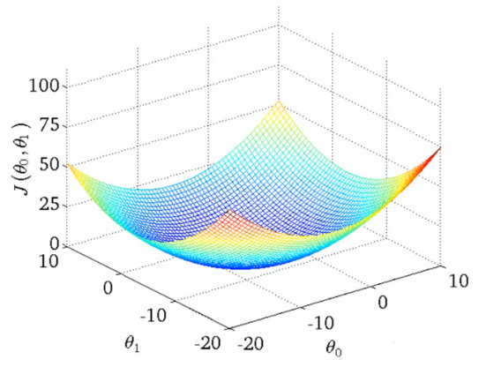
Linear Regression – Cost Function Two or more constants - Example (4/10)
Function of the parameters θ₀, θ₁
We can see that the height (y) indicates the value of the cost function, so find where y is at a minimum

Slide 32
Linear Regression – Cost Function Two or more constants - Example (5/10)
Instead of a surface plot we can use a contour figures/plots
Set of ellipses in different colors
Each color is the same value of J(θ₀, θ₁), but obviously plot to different locations because θ₁ and θ₀ will vary
Imagine a bowl shape function coming out of the screen so the middle is the concentric circles

Slide 33
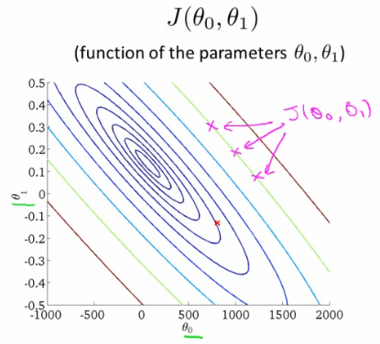
Linear Regression – Cost Function Two or more constants - Example (6/10)
x

Slide 34
Linear Regression – Cost Function Two or more constants – Example (7/10)
Each point (like the red one above) represents a pair of parameter values for Ɵ₀ and Ɵ₁
Our example here put the values at
θ₀ = ~800
θ₁ = ~-0.15
Not a good fit
i.e. these parameters give a value on our contour plot far from the center

Slide 35
Linear Regression – Cost Function Two or more constants – Example (8/10)
If we have
θ₀ = ~360
θ₁ = 0
This gives a better hypothesis, but still not great - not in the center of the contour plot
Finally we find the minimum, which gives the best hypothesis
Doing this by eye/hand is a pain
What we really want is an efficient algorithm fro finding the minimum for θ₀ and θ₁

Slide 36
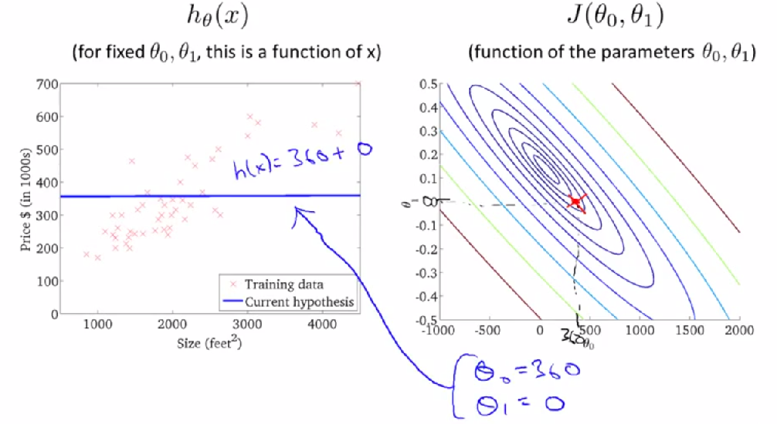
Linear Regression – Cost Function Two or more constants – Example (9/10)
x

Slide 37
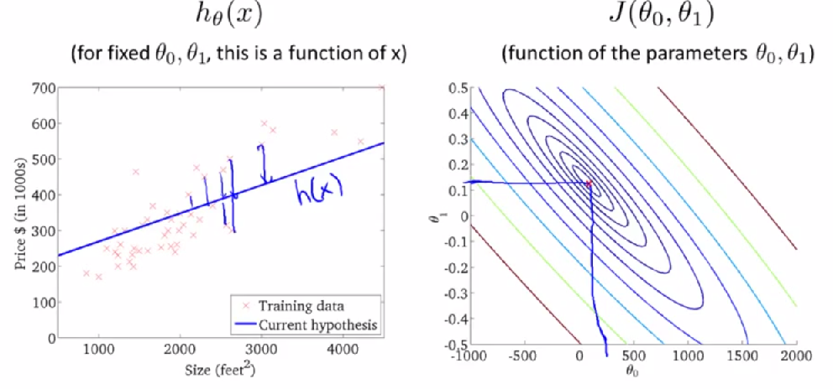
Linear Regression – Cost Function Two or more constants – Example (10/10)
x

Slide 38
Gradient Decent Algorithm
It uses all over machine learning domain for finding the minimum cost function
IMPORTANCE
After finding the first values of parameters of θ then it would be difficult to find the next best value of θ which converge the minimum of cost function.
Basically, gradient descent algorithm depends on first order newton Rapson’s method

Slide 39
Gradient Decent Algorithm
The more generalized gradient decent algorithm is
repeat until convergence {
(simultaneously updated j= 0 and j=1)
}
here, α = learning rate

Slide 40
Gradient Decent Algorithm - Example
Consider the previous example, where we have selected single parameter θ₁ then the cost function is
min J(θ₁)
The derivative of any curve at specific point produces the slope of tangent at same point

Slide 41
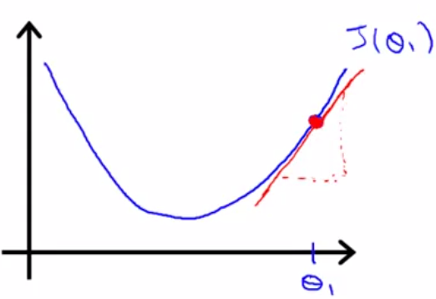
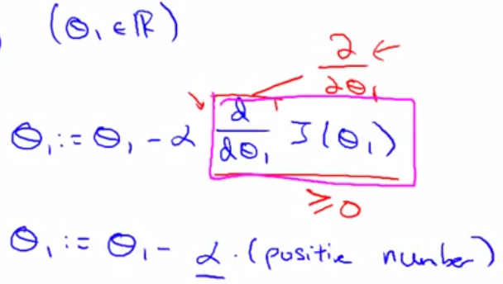
Gradient Decent Algorithm - Example
Suppose our cost function is

Slide 42
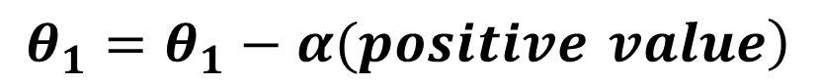
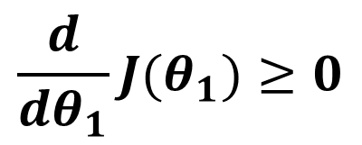
Gradient Decent Algorithm - Example
In given diagram, at point θ₁, the slope of tangent produces the positive value because of the acute inclination
then
positive value of
now gradient descent function
$$\frac{d}{dθ_{1}}J(θ_{1})≥0$$
$$\left.θ_{1}=θ_{1}−α(positive value\right)$$

Slide 43
Gradient Decent Algorithm - Example
In this case the value of new θ₁ will be smaller then the old θ₁
It will move (converge) to left side and approach to
min J(θ₁)

Slide 44
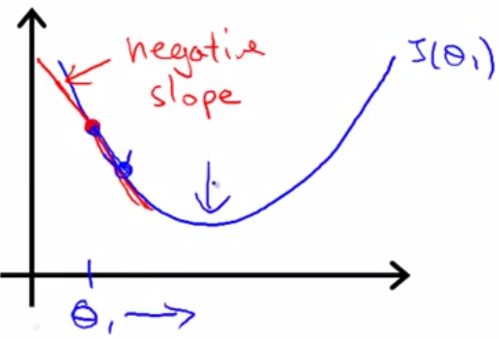
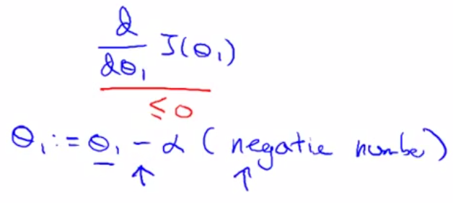
Gradient Decent Algorithm - Example
Consider the second diagram

Slide 45
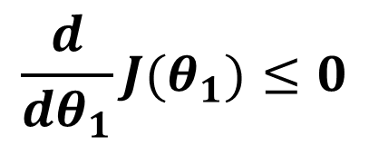
Gradient Decent Algorithm - Example
Here at the point θ1, the derivative value (slope of the tangent) will be negative because of obtuse angle of tangent
negative value
now gradient descent function
$$\frac{d}{dθ_{1}}J(θ_{1})≤0$$
$$\left.θ_{1}=θ_{1}−α(negative value\right)$$

Slide 46
Gradient Decent Algorithm - Example
In this case the value of new θ₁ will be greater then the old θ₁
It will move (converge) to right-side and approach to
min J(θ₁)

Slide 47
Gradient Decent for Linear Regression
Gradient descent algorithm
repeat until convergence {
…(i)
}
see copy for further prove

Slide 48

Gradient Decent Algorithm

Slide 49
Cost Function with two parameters (θ₀ , θ₁)
Function of the parameters θ₀, θ₁

Slide 50
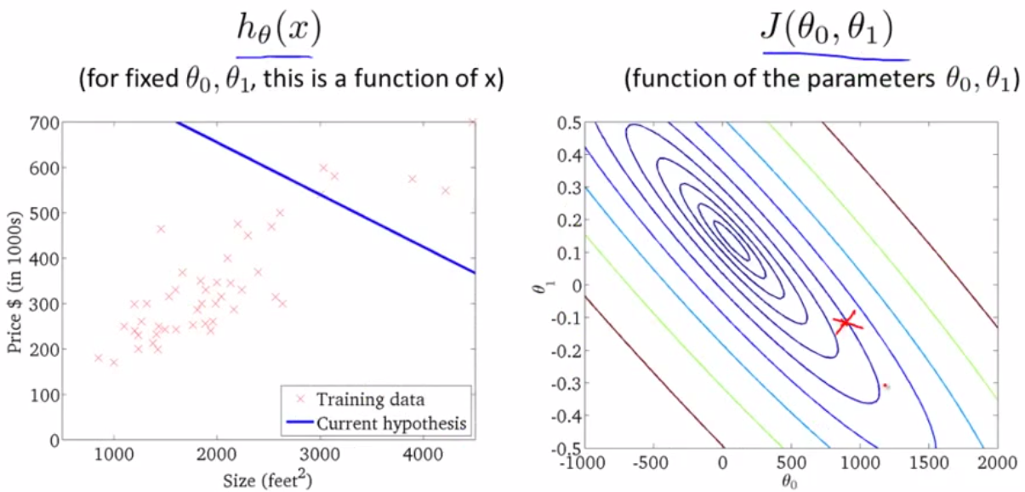
Gradient Decent Algorithm
_{s}

Slide 51
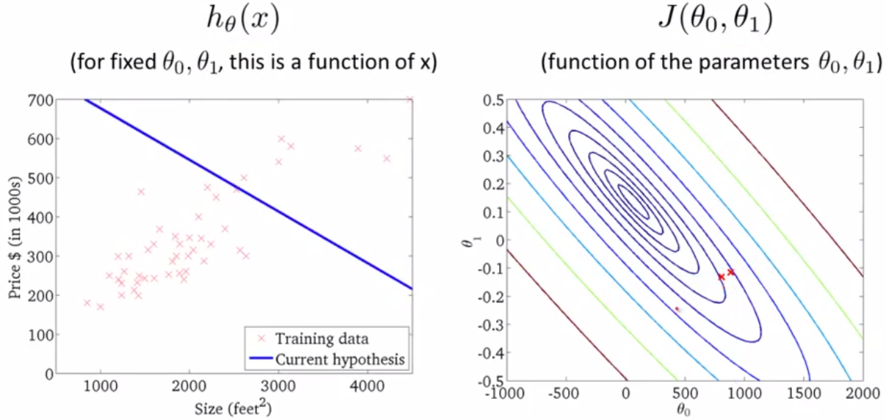
Gradient Decent Algorithm
_{s}

Slide 52
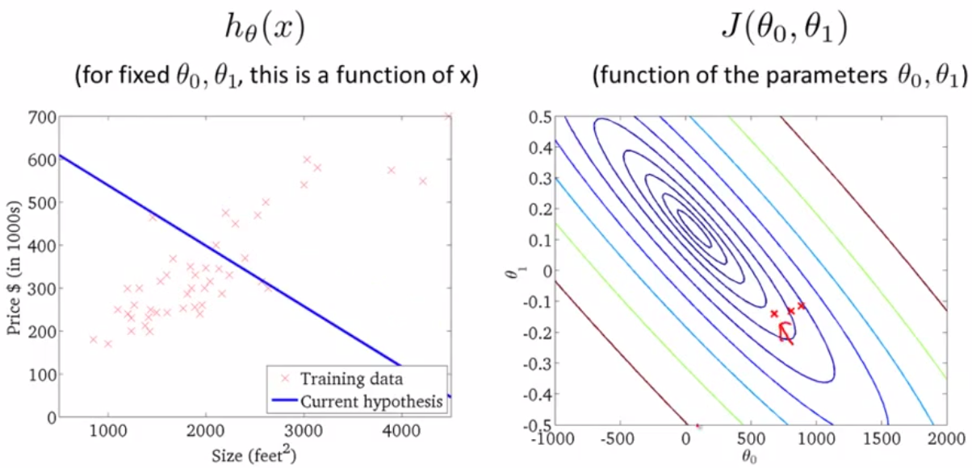
Gradient Decent Algorithm
_{s}

Slide 53
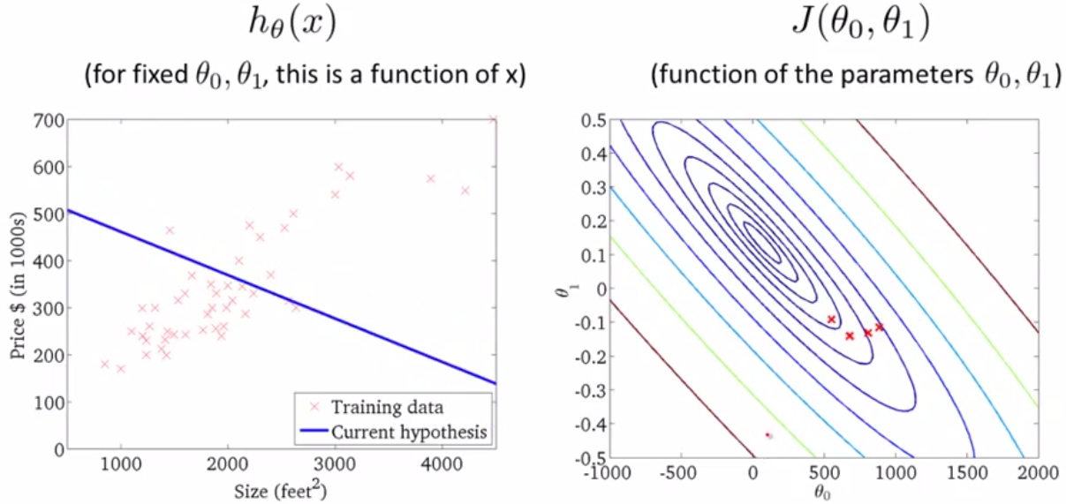
Gradient Decent Algorithm
_{s}

Slide 54
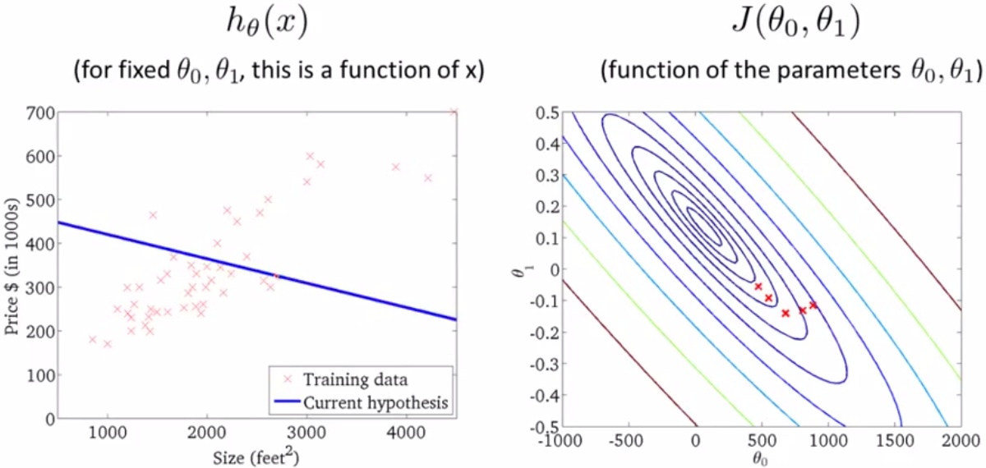
Gradient Decent Algorithm
_{s}

Slide 55
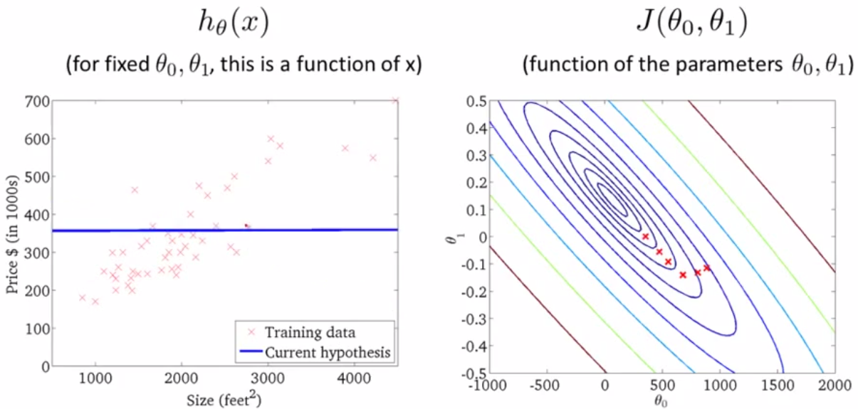
Gradient Decent Algorithm
_{s}

Slide 56
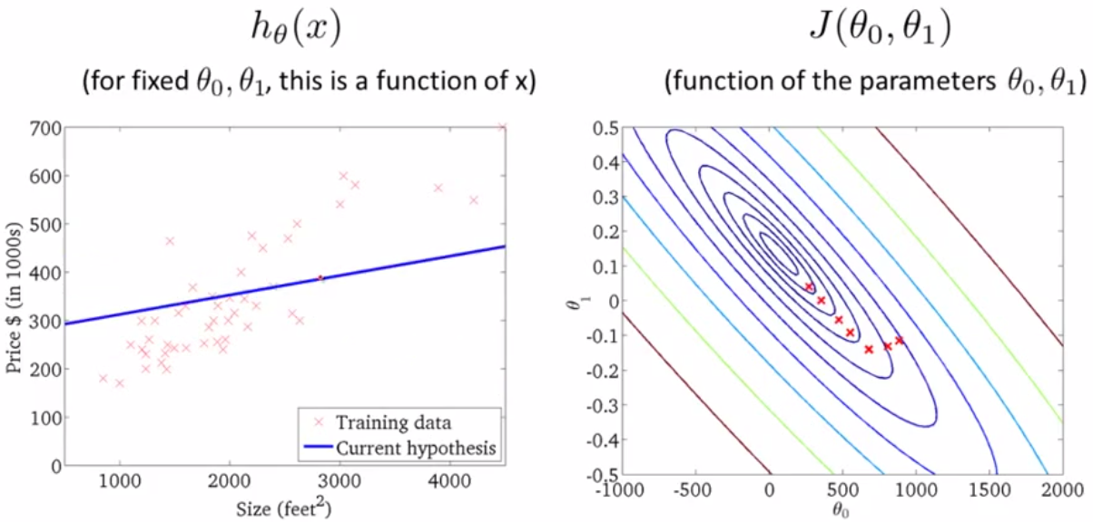
Gradient Decent Algorithm
_{s}

Slide 57
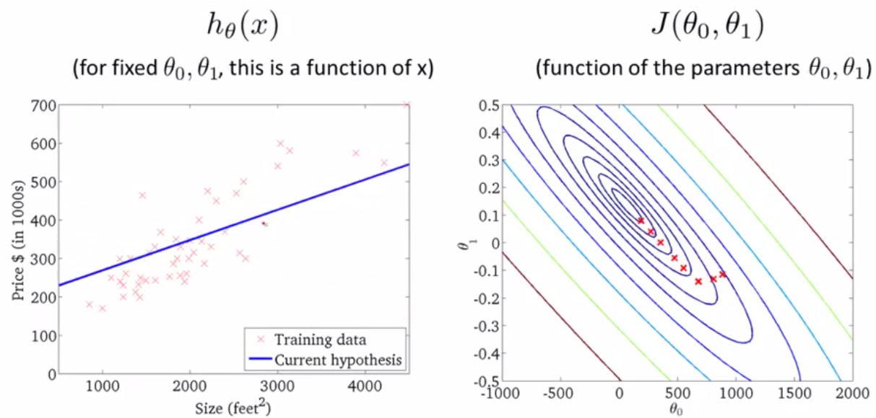
Gradient Decent Algorithm
_{s}

Slide 58
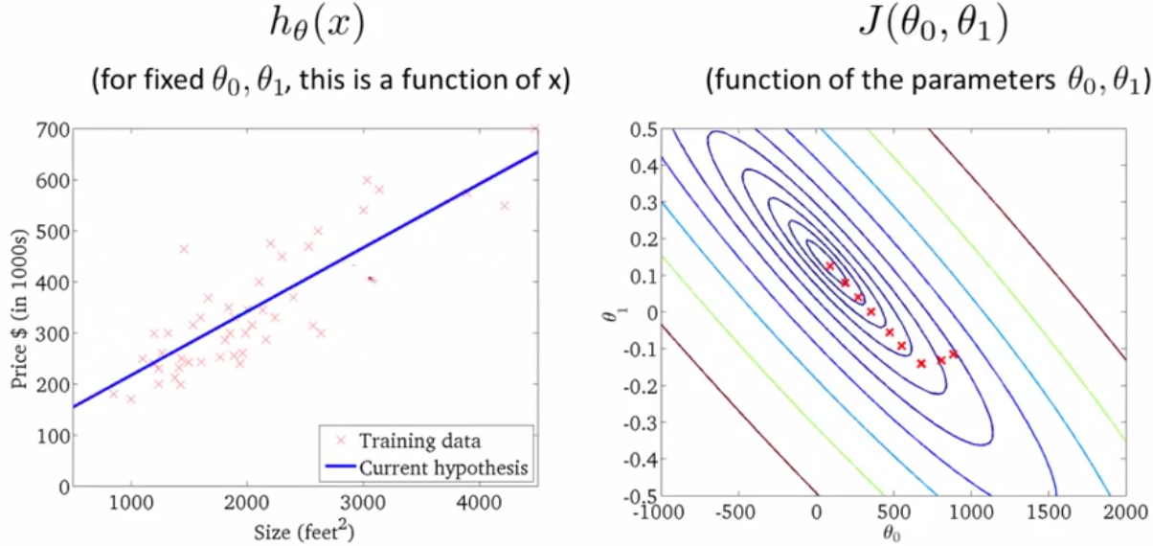
Gradient Decent Algorithm
_{s}

Slide 59
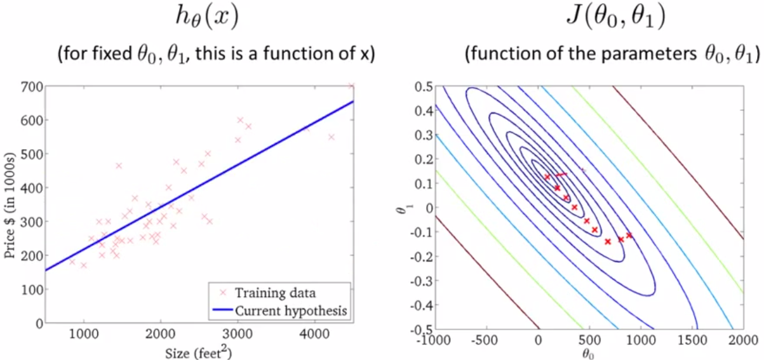
Gradient Decent Algorithm
_{s}

Slide 60
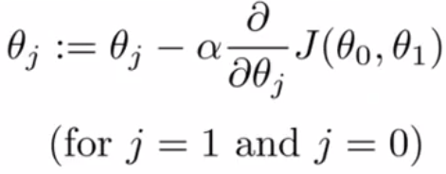
Gradient Decent for Linear Regression (1/4)
Consider the previous part of lecture
Gradient descent algorithm
repeat until convergence {
}

Slide 61
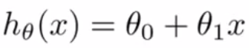
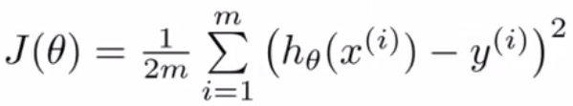
Gradient Decent for Linear Regression (2/4)
Linear Regression Model
Regression hypothesis
Cost Function

Slide 62
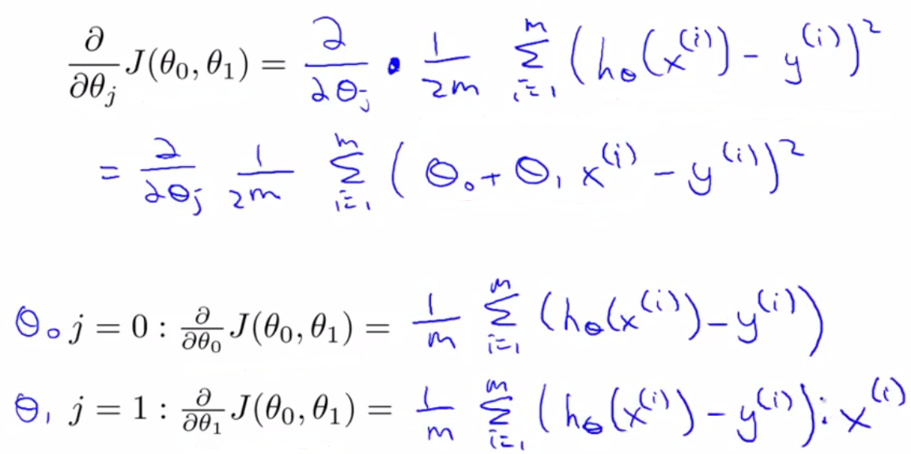
Gradient Decent for Linear Regression (3/4)
s

Slide 63
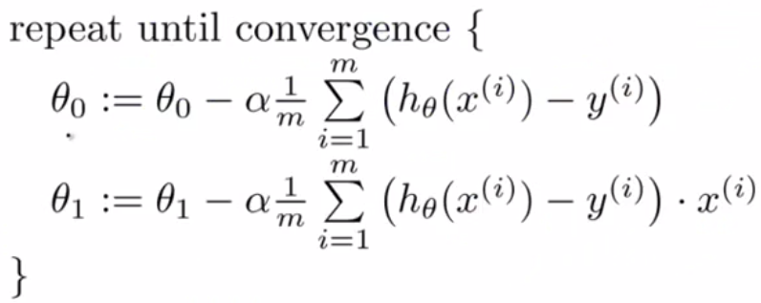
Gradient Decent for Linear Regression (4/4)
Updated θ₀ and θ₁ simultaneously

Slide 64
Gradient Decent for Linear Regression - Example
See in lecture notes

